Slide 1
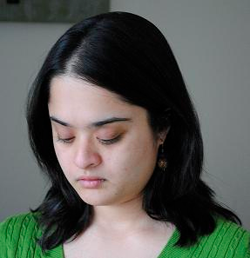

Image Classification: Features, Algorithms or Data?
Devi Parikh and Larry Zitnick

Slide 2
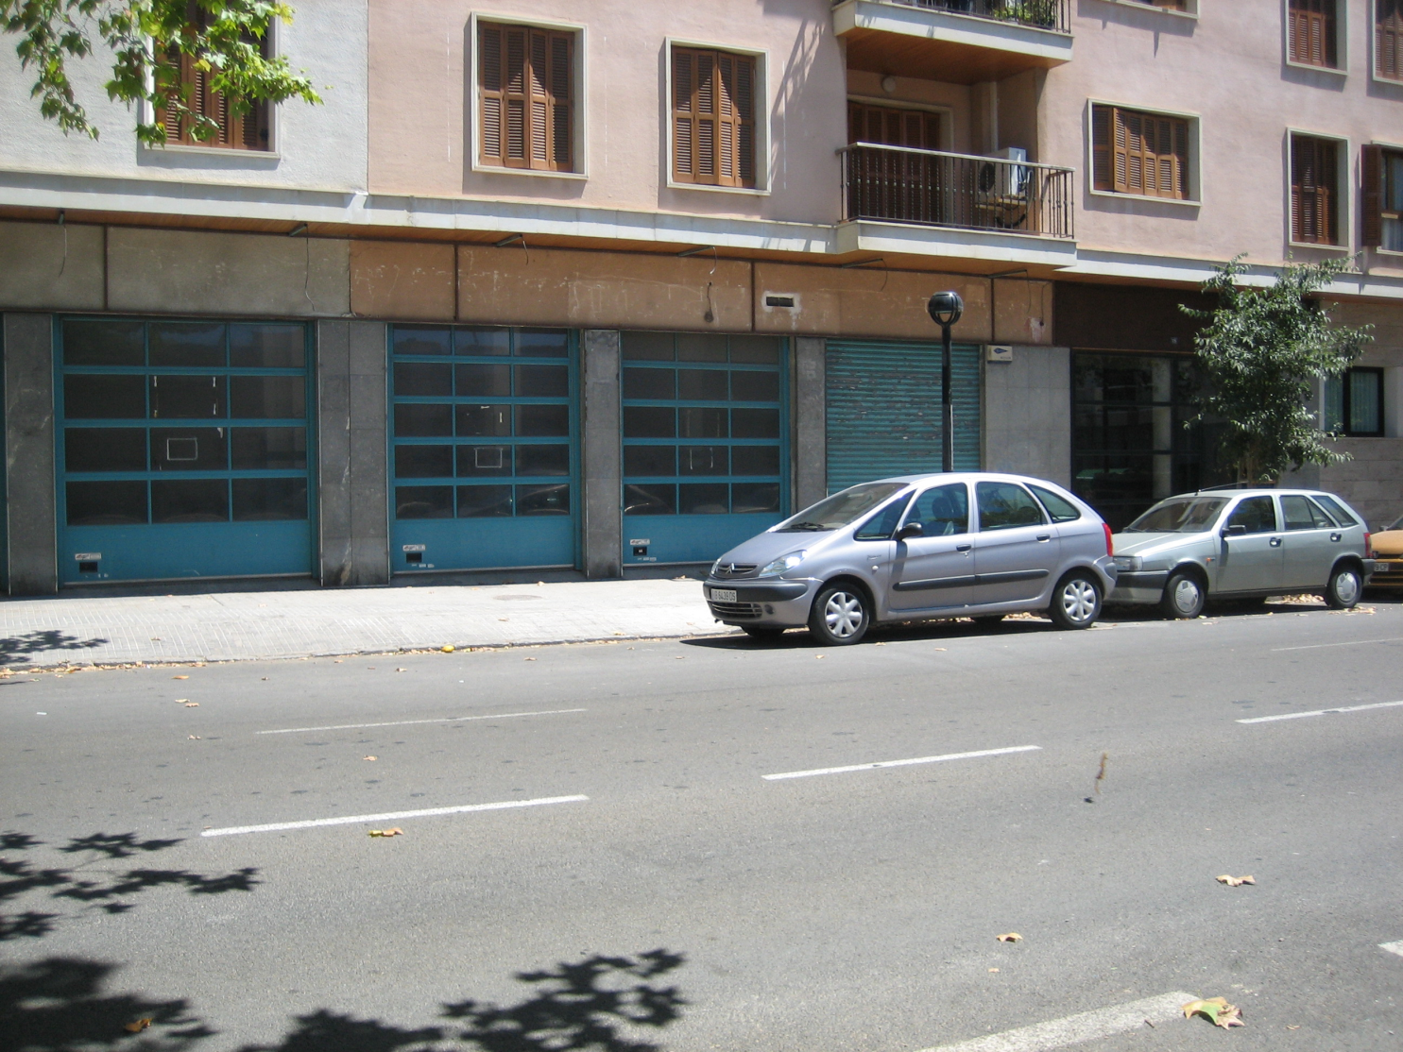
Computer Vision: Visual Recognition
Scene recognition
Object recognition
Object detection
WINDOWS
CAR
STREET

Slide 3

Computer Vision: Visual Recognition
Scene recognition
Object recognition
Object detection
Segmentation
WINDOWS
CAR
STREET

Slide 4
State of Machine Visual Recognition
Accuracy
Object Recognition
Scene Recognition
Object Detection
Segmentation
Machine
Human
…

Slide 5
State of Machine Visual Recognition
Accuracy
Complex systems: lot of progress
Where do we head next?
Machine
Human
Human-Debugging

Slide 6

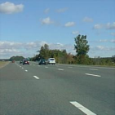
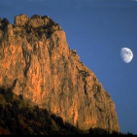

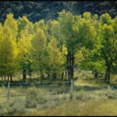
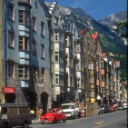
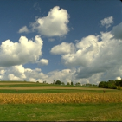
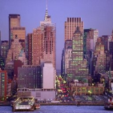
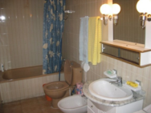
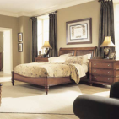
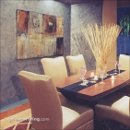
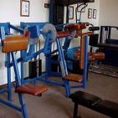
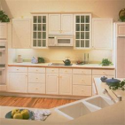
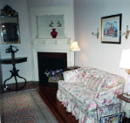
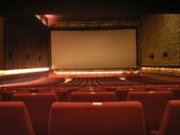
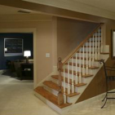




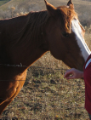


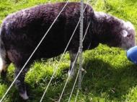

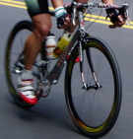


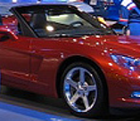
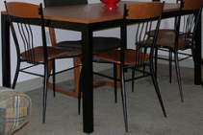
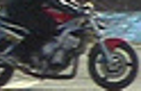
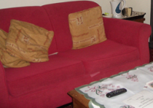
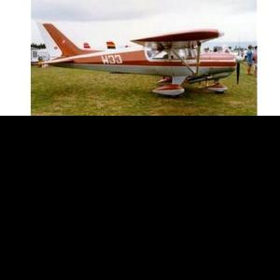
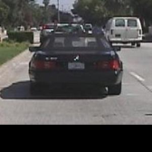


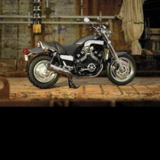
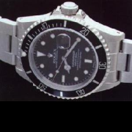
Image Classification
Coast
Highway
Mountain
Street
Forest
Inside city
Country
Buildings
Bathroom
Bedroom
Dining room
Gym
Kitchen
Living room
Theater
Stair case
Bird
Bottle
Cat
Dog
Horse
Person
Plant
Sheep
Aeroplane
Bicycle
Boat
Chair
Car
Dining table
Motorbike
Sofa
Aeroplane
Car-rear
Face
Ketch
Motorbike
Watch

Slide 7
The Recognition Game
D
c₁
c₂
…
…
c₁
c₂
.
.
.
.
.
.
.
.
.
.
.
.
.
.
.
.
…
…
…
F
A
…
…
Model / Classifier
c_{n}
…
…
…
c_{n}
.
.
.
.
.
.
.
.
.
.
.
.
.
.
.
.
.
.
.
.
c*

Slide 8
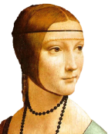
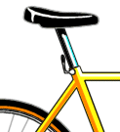
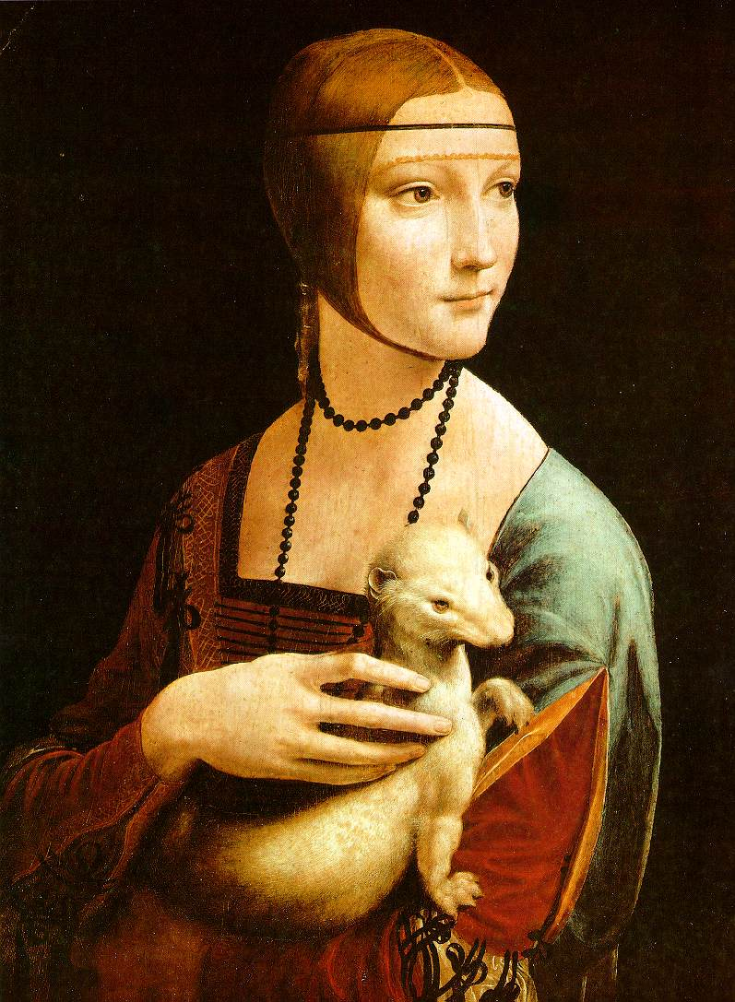
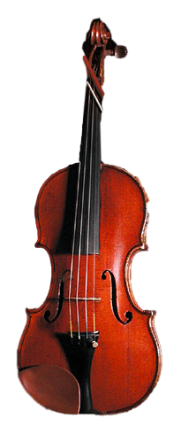
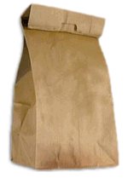



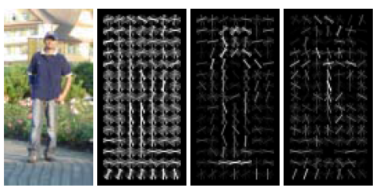
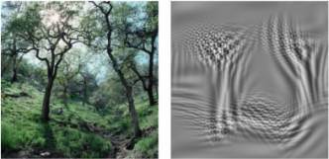
Existing Approaches: Features
[Fei-Fei et al., 2005]
[Lazebnik et al., 2006]
[Dalal et al., 2005]
[Oliva et al., 2001]

Slide 9
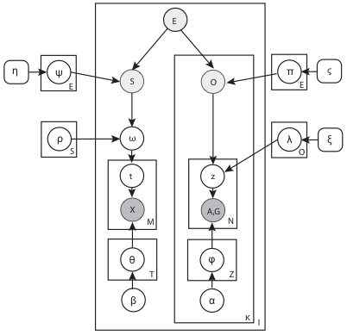
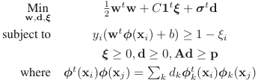
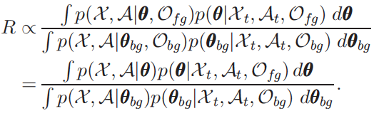
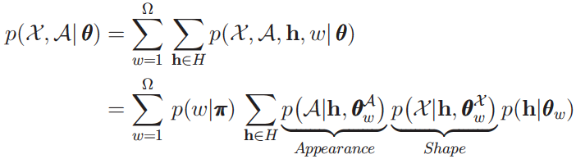
Existing Approaches: Algorithms
[Varma et al., 2007]
[Li et al., 2007]
[Fei-Fei et al., 2006]

Slide 10
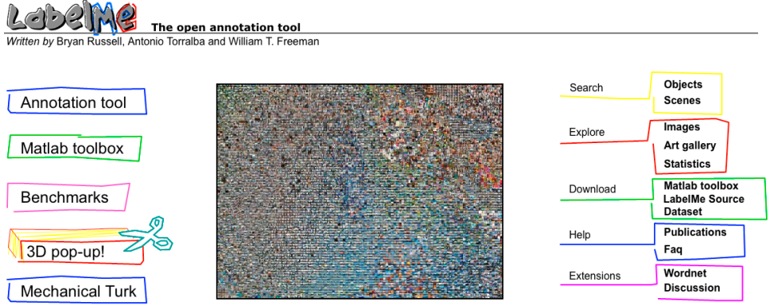

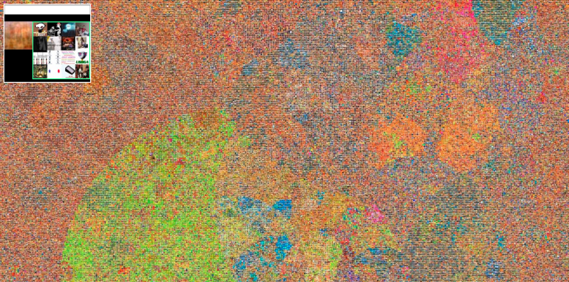
Existing Approaches: Data
70,000
[Russell et al., 2008]
14,000,000
80,000,000
[Deng et al., 2009]
[Torralba et al., 2008]

Slide 11
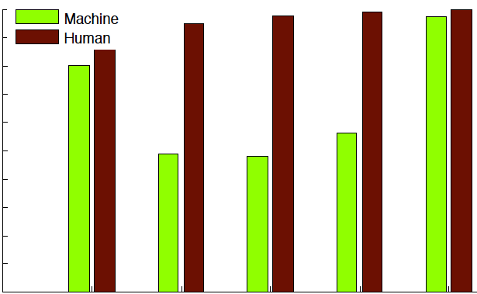
However…
Machine
Human
accuracy
outdoor scene recognition (2001)
indoor scene recognition (2009)
PASCAL 1 (2007)
PASCAL 2 (2007)
Caltech-6 (2004)

Slide 12
Goal
What makes humans superior to machines?
Features?
Data?
Algorithms?
Features
Algorithms
Data
Features
Algorithms

Slide 13
Set-up
Pose humans the problems we often pose to machines
D
c₁
c₂
…
…
F
A
…
Model / Classifier
…
c_{n}
c*

Slide 14
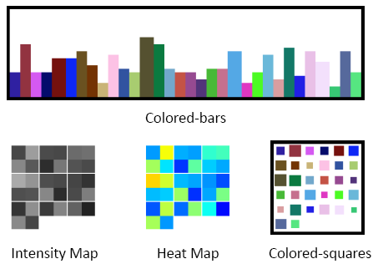
No prior
Colored-bars
Intensity-map
Heat-map
Colored-squares

Slide 15
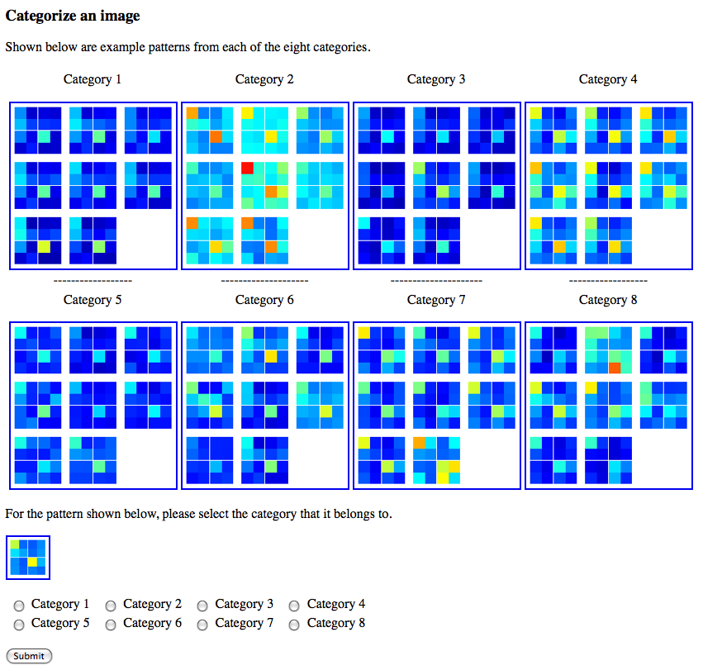

Humans

Slide 16
Scenarios: Datasets
Coast
Highway
Mountain
Street
Forest
Inside city
Country
Buildings
OSR
Bathroom
Bedroom
Dining room
Gym
Kitchen
Living room
Theater
Stair case
ISR
Bird
Bottle
Cat
Dog
Horse
Person
Plant
Sheep
PA1
Aeroplane
Bicycle
Boat
Chair
Car
Dining table
Motorbike
Sofa
PA2
Aeroplane
Car-rear
Face
Ketch
Motorbike
Watch
CAL

Slide 17
Scenarios: Features
Color-histogram (CH)
CAL: Bag-of-words (BOW)
[Fei-Fei et al., 2005]
Texture-histogram (TH)
Has wood
Has cloth
Has head
Is round
PA: Attributes (ATT)
[Farhadi et al., 2009]
Gist [Oliva et al., 2001]

Slide 18
Scenarios
# training examples per category
2, 4, 8, 16, 32, 64, 100
Dimensions (except ATT, BOW)
4, 8, 16, 32, 64, 128, 256
Noise
0%, 25%, 50%, 100%, 200%

Slide 19
Algorithms
NN: Nearest neighbor
NCM: Nearest category-mean
NET: Neural network
DT: Decision tree
LDA: Dimensionality reduction (PCA+LDA) + linear SVM
BOOST: Boosting with linear SVM on individual features
LSVM: Linear SVM
QSVM: SVM with quadratic polynomial kernel
CSVM: SVM with cubic polynomial kernel
RBFSVM: SVM with radial basis kernel
Human

Slide 20
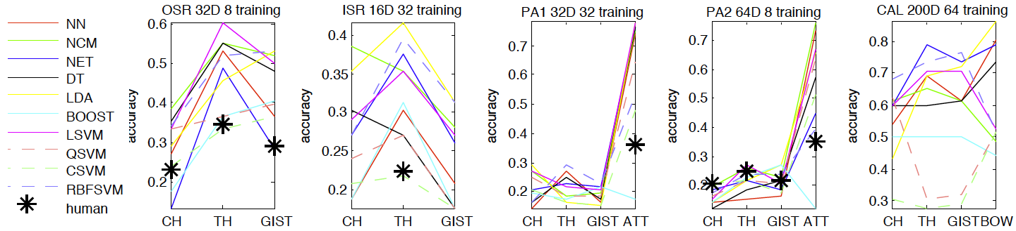
Role of Algorithms

Slide 21
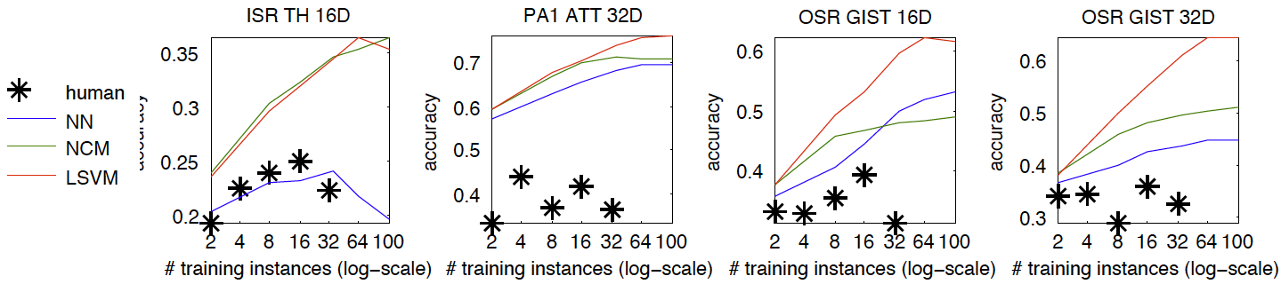
Role of Data

Slide 22
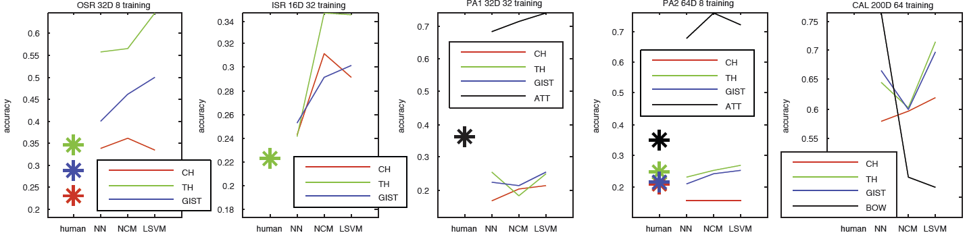
Role of Features

Slide 23
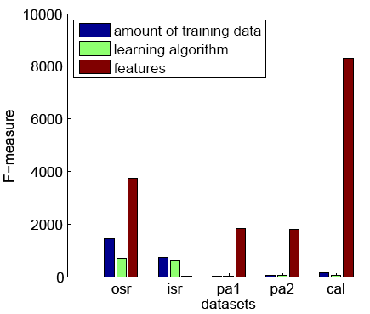
Role of Features
Image representation is the most influential factor

Slide 24
Discussion
Do subjects use nearest neighbor?
Visual vs. non-visual “features”
Beyond “features”?
Attributes
Multiple tasks
Learning

Slide 25
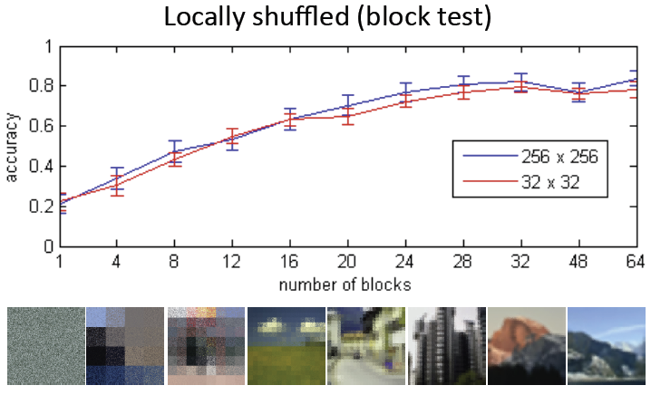
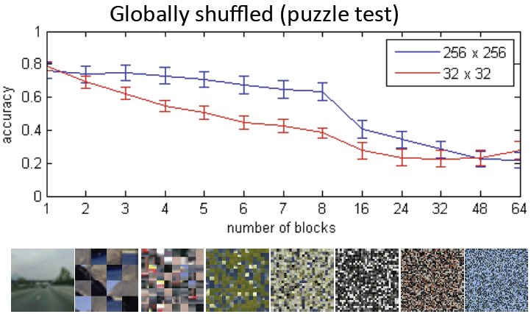
Role of Features
Adaptability

Slide 26
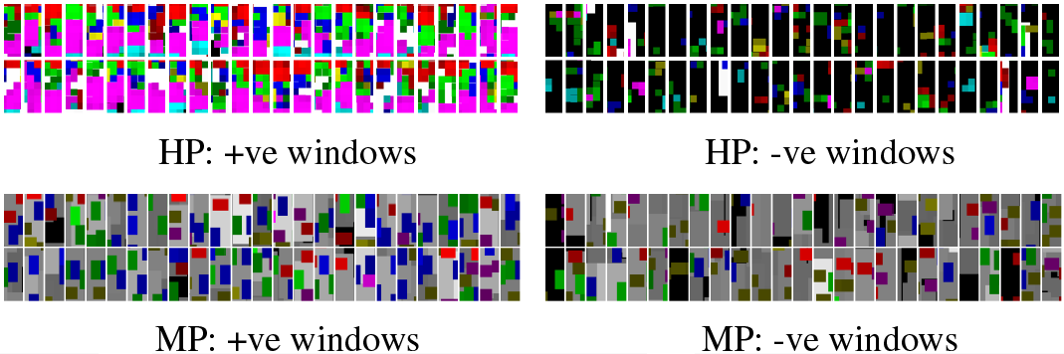

Challenges
Accessing isolated human models
Visualizing high-dimensional data
Invoking natural visual pathways
[Chernoff, 1973]

Slide 27
Conclusion
Accuracy
Humans are a working system!
Interactive
Figure our brains out
Label training data
Design algorithms
Debug our systems!
Machine
Human

Slide 28
Thank you!

